Slide 1
Nature and Scope of Comparative Politics
Gangesh Kr Jha
Assistant Prof.
Deptt. Of Political Science
Marwari College,Darbhanga

Slide 2
Comparative Government vs Comparative Politics
Though Comparative Government and Comparative Politics are two different subjects, yet the modern scientists have laid emphasis on the combined study of both for obvious reason. Further, comparative method has been used for the study of both .
Aristotle, well known Greek Philosopher attempted for the first time to understand the state, not so well known idea in those days. He went on to study and analyze almost 158 Constitutions to arrive at his famous classification of “Government” into 6 broad types depending upon the number and the purpose of power beholden by the people.

Slide 3
Comparative Politics:Essence
Comparative politics studies a broader range of political activity, including government and their institutions as well as other forms of organizations not directly related national government,e.g,tribes,communities,associations,unions.
In other words it studies political as well as non-political actors and their attendant institutions.

Slide 4
Meaning of Comparative Politics
Edward Freeman, “Comparative Politics is the comparative analysis of the various forms of governments and diverse political institutions”.
Michael Curtis, “Comparative Politics is concerned with significant regularities, similarities and differences in the working of Political institutions and in political behaviour.”

Slide 5
Growth of the Discipline
Comparison with others has been a common habit in humans. We compare many things with others to make the right decision, and the history of this human trait is as old as the existence of human civilization. The same applies in the case of comparative politics.
In the book named The Politics, written by Aristotle, has the mention of comparative politics. In this book, he compares “constitutions”, by introducing his famous typology. Aristotle made a comparison of 158 countries, and that’s how comparative politics was started.

Slide 6
Historical Growth
As civilization progresses and new changes in the state system occured,Comparative Politics underwent broadly five phases of transformations to allow political scientists to grasp phenomenon in more subtle ways:
State and System Theories
Cultural Theories
Developmental Theories
Class theories
Political Economy Theories

Slide 7
Characteristics of Comparative Politics
Descriptive Studies
Historical-legalistic institutional studies
Parochial
Static
Monographic

Slide 8
Approaches to Comparative Politics
Institutional-an approach to the study of politics and government that focuses more on structure and dynamics of governing institutions (comparison of formal instt.)
Structural- an approach to study of politics and government that empahasises the relationships among groups and networks within larger system
cultural-an approach to the study of politics and government based on understanding the influence of culture and cultural norms(how cultural norms and practices support or undermine different political preferences and forms)
Rational Choice-an approach to the study of politics and government based on the idea that individuals work to maximize their benefits and minimize their costs.(ability to model the essential political actions and make predictions).
Interpretative- an approach to the study of politics and government based on the argument that politics is formed by the ideas we have about it

Slide 9
Nature of Comparative Politics
Analytical and Empirical investigation
Comparative study of the formal and informal structures
Study of infra-structures
Emphasis on the study of Developing Societies
Emphasis on the Inter-disciplinary method of study
Value-free study
Quest of theory building
Horizontal and vertical comparison

Slide 10
Scope of Comparative Politics
All political structures-includes the study of all the formal and informal, governmental, and extra-governmental institutions and their structure;
Functional-the knowledge of how all the formal and informal institutes work within the country;
Study of political behaviour- the study of voting behavior, political participation, leadership recruitment, elite behavior, mass politics, etc.;
Study of similarity and differences-How two countries are similar and how are they different from each other; and
Study of all political systems-the political system of any country defines its nature and the voting culture.

Slide 11
Scope of Comparative Politics: in nutshell
1. Comparative study of Political systems
2.Study of constitutional systems
3.Study of Political culture
4. Study of political Socialization
5.Study of political Ideologies
6. Study of political Participation
7. Study of interest groups
8.Study of power, Influence and authority
9.Study of Political Elites, Political Violence and Political Corruption.
10. Study of Political Processes
11. Study of Problems of modernization and urbanization
12. Study of the role of the Bureaucracy 
13. Study of the political Activities

Slide 12
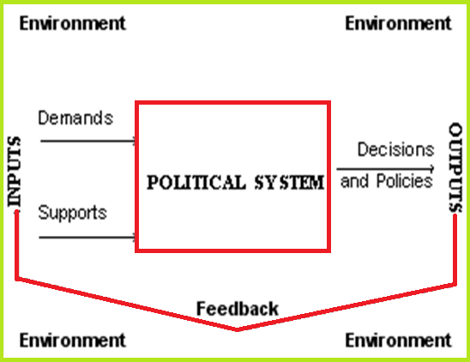
System Theory: How it works

Slide 13
Problems of Comparative Politics
Lack of common terminology ;
Problems of fact-finding ;
Wide range of variables;
Gap between Constitutional Forms and Political Realities ;
Problem of inter-connection between values behaviour;
Fickle mindedness of Man;
Problem of defining of the boundaries;and
Universally acceptable results are not possible.

Slide 14
References
Hague,Rod,Harrop,Martin & McCormick, John(eds.),Comparative Government and Politics,macmillan international,2019
Chilcote,Ronald H,Theories of Comparative Politics :The search for a paradigm reconsidered,Westview Press,1994
Eckstein,H &Apte D.C.,Comparative Politics;A Reader

